Slide 1
45 Printable cards
+ sample questions
Rules
Put on a headband.
Give out three chips to each player.
Grab a card from the pile.
Put the card on your headband AND DON'T LOOK AT THE CARD.
The youngest player goes first. Then, play passes to the left.
Flip over the timer and ask other players questions about your card.
You can use any question except, "What am I? "
If you guess the picture before the timer runs out, take another card.
Continue asking questions until the timer runs out.
For each picture you guess correctly, put one of your chips in the bank.
At any point during your turn, you can give up trying to guess.
If you do, you must collect one chip from the bank.

Slide 2
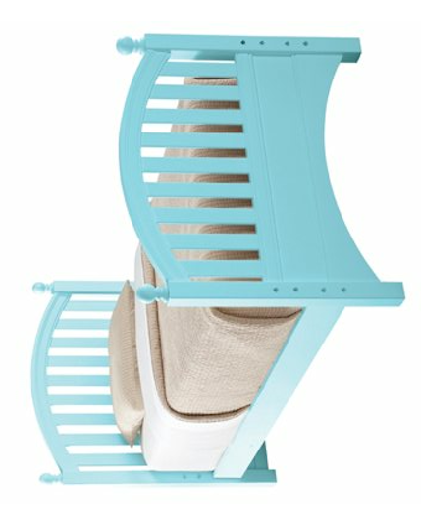
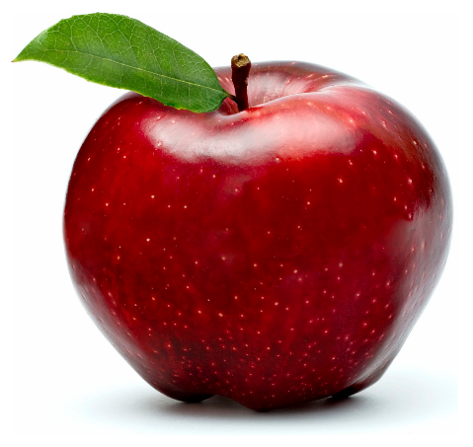
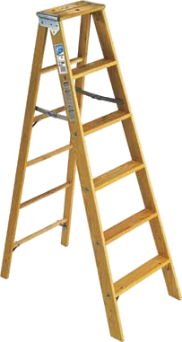
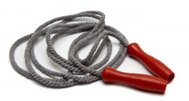
I am a bed
I am a light
bulb
I am an apple
I am a jumping
rope
I am a ladder

Slide 3
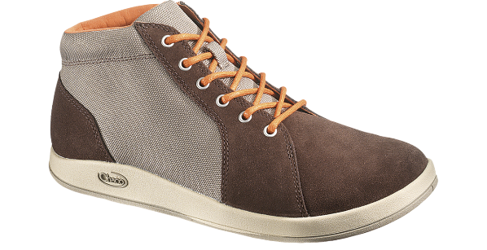
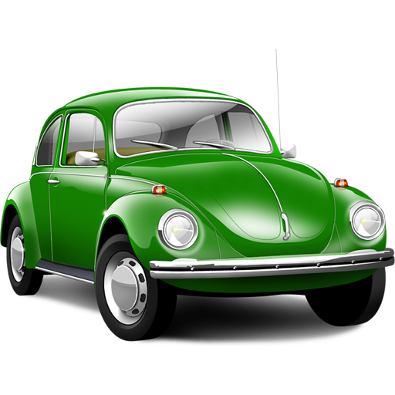
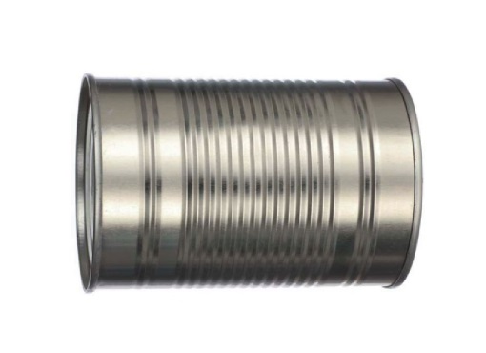
I am a shoe
I am a bottle
I am a car
I am a can
I am money

Slide 4
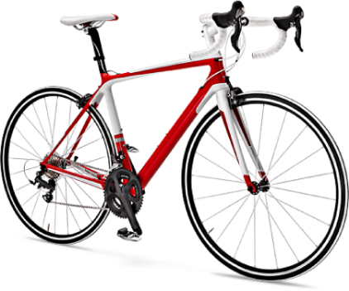
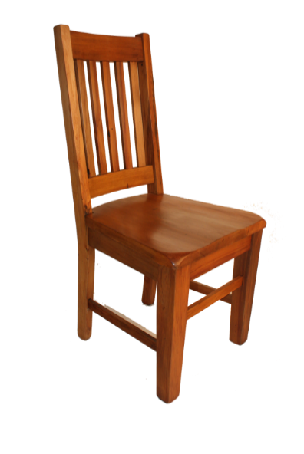
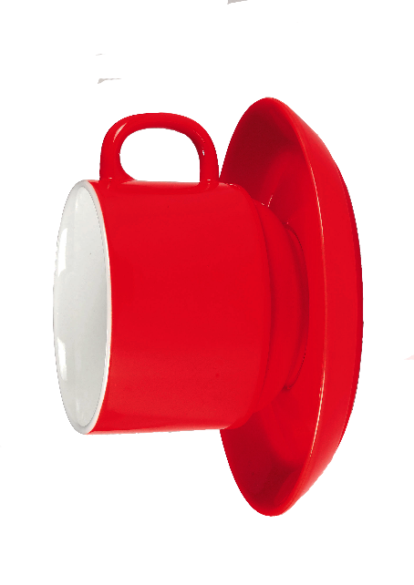
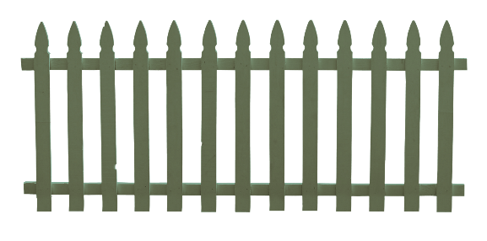
I am a cap
I am a bicycle
I am a chair
I am a fence
I am a cup

Slide 5
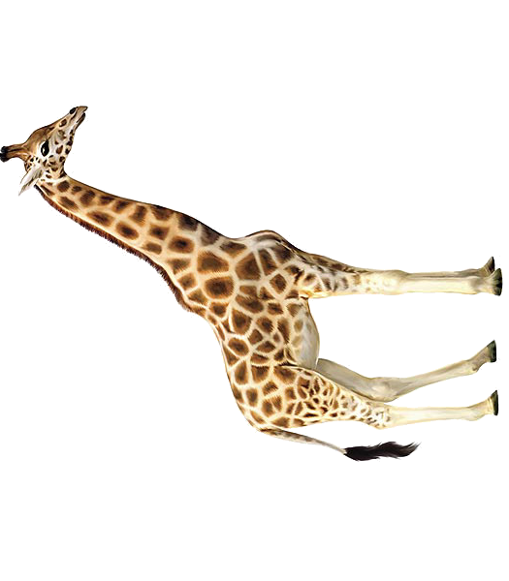
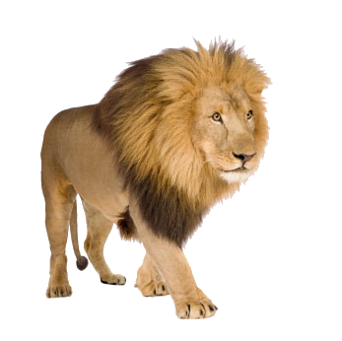
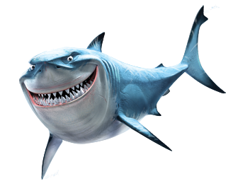
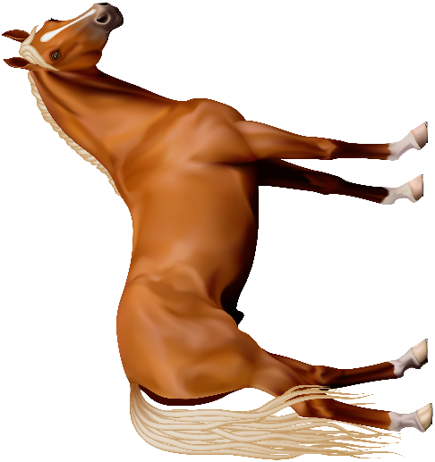
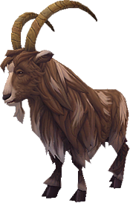
I am a giraffe
I am a lion
I am a shark
I am a horse
I am a goat

Slide 6
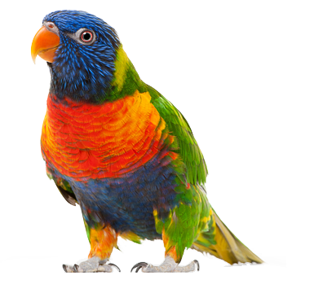
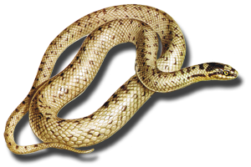
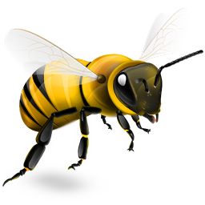
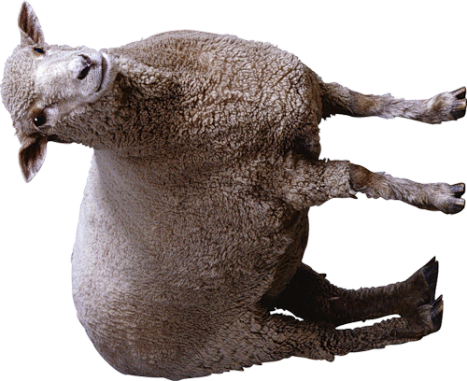
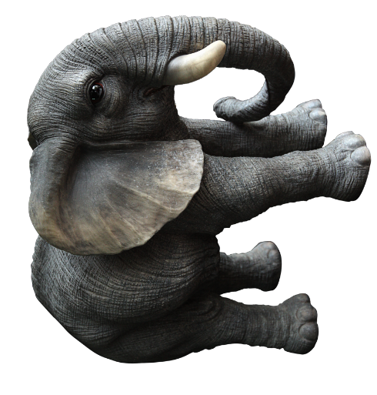
I am a parrot
I am a snake
Я змея
I am a bee
Я пчела
I am a sheep
I am an
elephant
Я слон

Slide 7
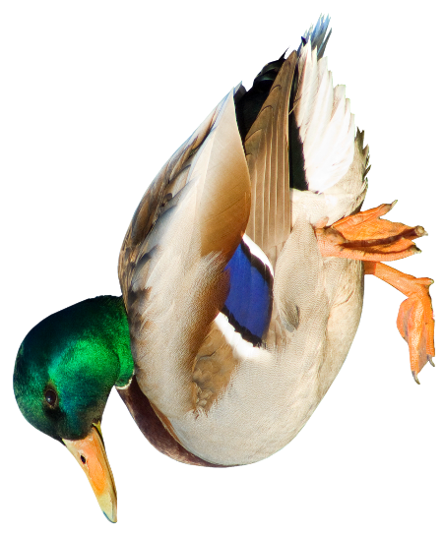
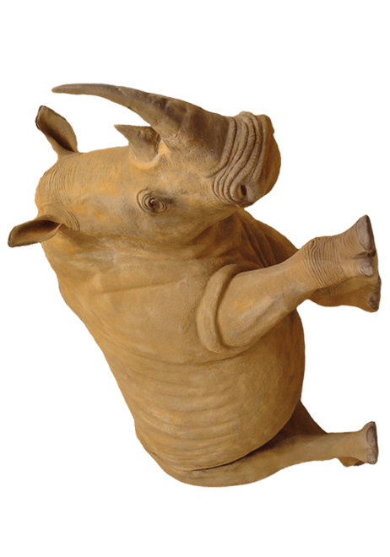
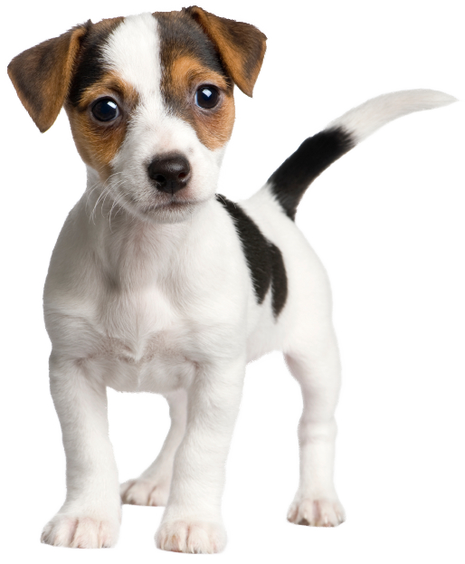
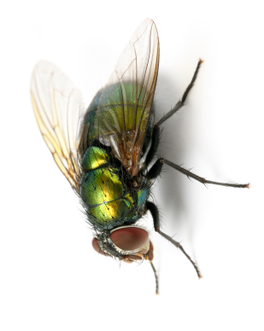
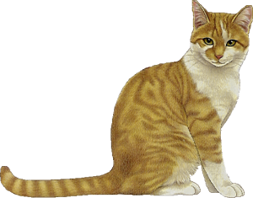
I am a duck
I am a rhino
Я утка
Я носорог
I am a puppy
Я щенок
I am a fly
I am a cat
Я кошка

Slide 8
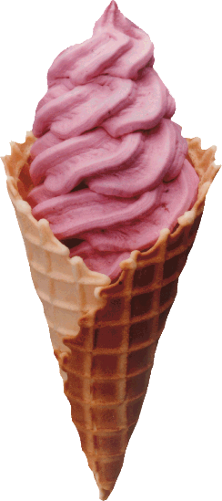
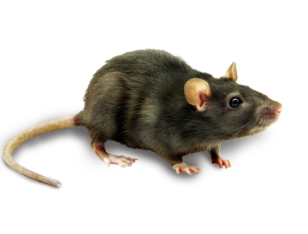
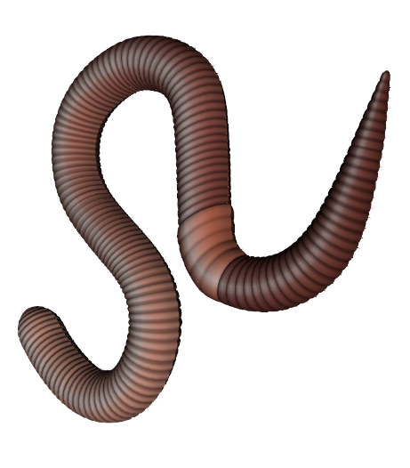
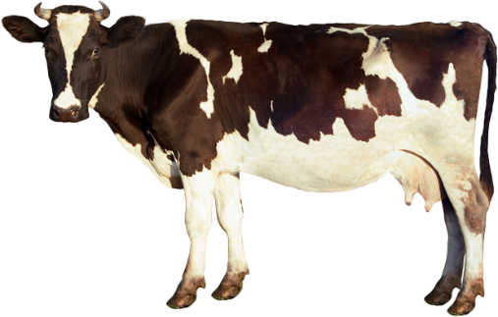
I am a mouse
I am ice cream
I am
French fries
I am a cow
I am a worm

Slide 9
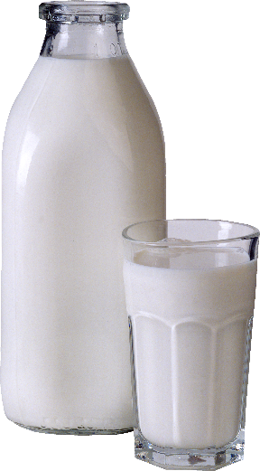
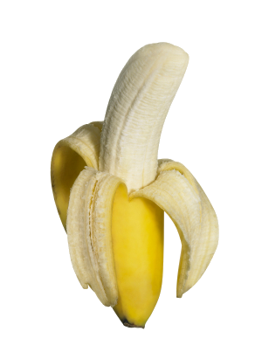
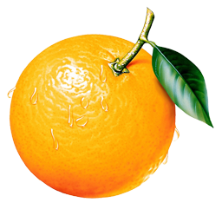
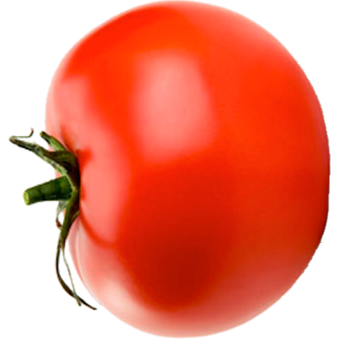
I am milk
I am a banana
Я банан
I am a spoon
I am a tomato
I am an orange

Slide 10
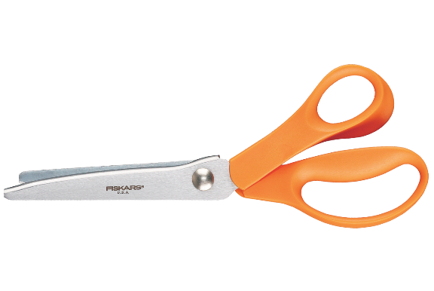
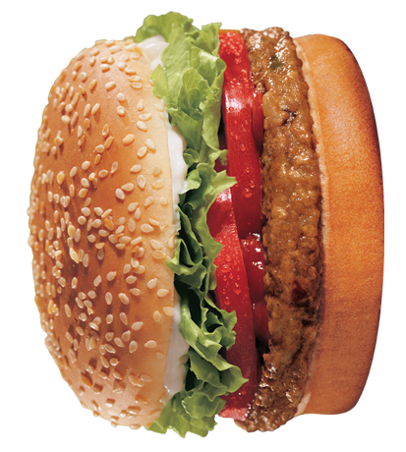
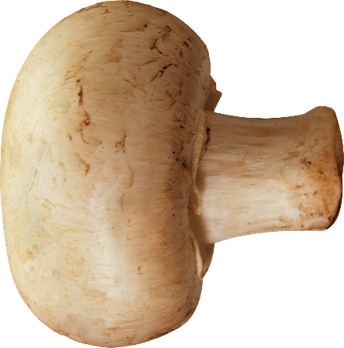
I am scissors
I am a cake
I am a fork
I am a
mushroom
I am a burger

Slide 11
Sample Questions
Do I have legs? Could I be a pet? Am I an animal?
Can I swim? Do I make noise? Can I be eaten? Do I have fur? Am I a person? Can I fly? Am I a vegetable? Am I heavy? Am I alive?
Sample Questions
Do I have legs? Could I be a pet? Am I an animal?
Can I swim? Do I make noise? Can I be eaten? Do I have fur? Am I a person? Can I fly? Am I a vegetable? Am I heavy? Am I alive?
Sample Questions
Do I have legs? Could I be a pet? Am I an animal?
Can I swim? Do I make noise? Can I be eaten? Do I have fur? Am I a person? Can I fly? Am I a vegetable? Am I heavy? Am I alive?
Sample Questions
Do I have legs? Could I be a pet? Am I an animal?
Can I swim? Do I make noise? Can I be eaten? Do I have fur? Am I a person? Can I fly? Am I a vegetable? Am I heavy? Am I alive?
Sample Questions
Do I have legs? Could I be a pet? Am I an animal?
Can I swim? Do I make noise? Can I be eaten? Do I have fur? Am I a person? Can I fly? Am I a vegetable? Am I heavy? Am I alive?

